Slide 1

E – retail factors for customer activation and retention:
A case study from Indian E – commerce customers.
Presented By: Shantanu

Slide 2
Contents
Problem Statement & Objective 3 – 4
Literature Review 5
Exploratory Data Analysis 6 – 20
Conclusion 21

Slide 3

1. Problem Statement & Objective
Q: What is Customer Retention?
Customer Retention refers to a company’s ability to turn customers into repeat buyers and prevent them from switching to a competitor. It indicates whether your product and the quality of the service please your existing customers. Customer Retention strategies are the processes and initiatives businesses put in place to build customer loyalty and improve customer lifetime value.
Q: Why is it important?
Customer retention increases your customers’ lifetime value and boosts your revenue. It also helps you build amazing relationship with your customers. You aren’t just another website or store. They trust you with their money because you give them value in exchange. According to the Harvard Business Review, acquiring a new customer can be 5 to 25 times more expensive than holding on to an existing one. You don’t need to spend big on marketing, advertising or sales outreach. It is easier to turn existing customers into repeating ones, since they already trust your brand from previous purchases. New customers, however, often require more convincing when it comes to the initial sale.
Q: What are its benefits?
Retention is Cheaper than Acquisition
Loyal Customers are more profitable.
Your Brand will stand out from the crowd.
Engage customers provide more feedback.
Loyal customers are more forgiving.
Customers will explore your brand

Slide 4
1. Problem Statement & Objective Contd…
Customer Retention refers to the action and strategies a business uses to try and keep existing customers. To enable these actions, customer retention analytics provide predictive metrics of which customer might churn-which enable them to get ahead of it. Customer satisfaction and customer loyalty. A comprehensive review of the literature, theories and models have been carried out to propose the models for customer activation and customer retention. Five major factors that contributed to the success of an e-commerce store have been identified as: service quality, Customer satisfaction has emerged as one of the most important factors that guarantee the success of online store; it has been posited as a key stimulant of purchase, repurchase intentions system quality, information quality, trust and net benefit. The research furthermore investigated the factors that influence the online customers repeat purchase intention. The combination of both utilitarian value and hedonistic values are needed to affect the repeat purchase intention (loyalty) positively. The data is collected from the Indian online shoppers. Results indicate the e-retail success factors, which are very much critical for customer satisfaction. Analytical skills has been applied to give findings and conclusion in detail.

Slide 5

2.Literature Review
Customer satisfaction has emerged as one of the most important factors that guarantee the success of online store; it has been posited as a key stimulant of purchase, repurchase intentions and customer loyalty. A comprehensive review of the literature, theories and models have been carried out to propose the models for customer activation and customer retention. Five major Factors that contributed to the success of an e-commerce store have been identified as service quality, system quality, information quality, trust and net benefit. The research furthermore investigated the factors that influence the online customers repeat purchase intention.
Purchase Intention
User Satisfaction
Net Advantages
Data Quality
Framework Quality

Slide 6


3.Exploratory Data Analysis
There are 269 rows and 71 columns.
There are no missing values in the dataset.
There are unwanted characters in columns.
There are 70 object type variable and one is int64 variable, however it is also categorical in nature.
Data Cleansings & Pre – processing
There are a lot of special characters and space in the column name.
There are numeric bullets in some of the columns we will remove it.
To fix the column problem following command has been used.

Slide 7
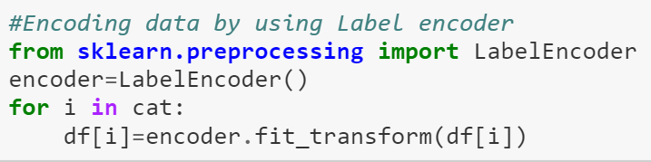

3.Exploratory Data Analysis Contd…
To encode Label encoder has been used.

Slide 8
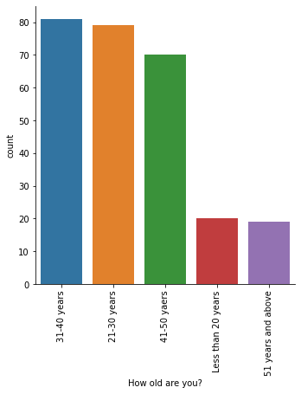
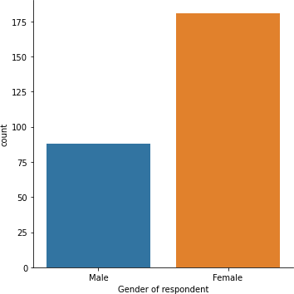
3.Exploratory Data Analysis Contd…
Univariate analysis
The female responders are double in number in comparison of male.
Majority of respondents are in age group of 20-50
There are very few respondents above 51 and below 20 years old.

Slide 9
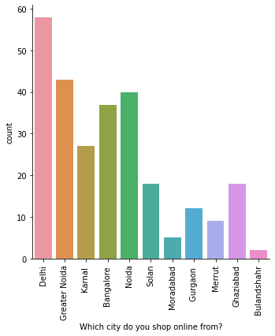
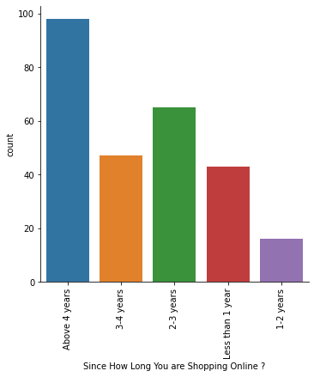
3.Exploratory Data Analysis Contd…
Delhi is the most prone for online shopping followed by Greater Noida and Noida
Moradabad and Bulandshahr has least number of shoppers.
Majority of people are shopping from more than 4 years.

Slide 10
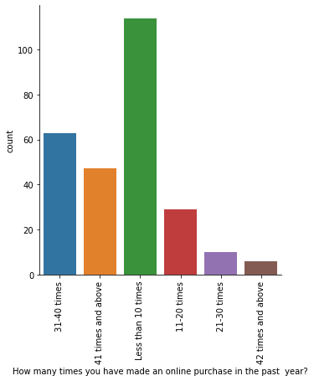
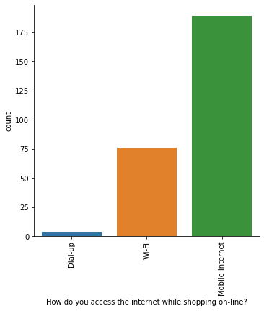
3.Exploratory Data Analysis Contd…
Majority of the respondents has shopped less than 10 times.
Very few are frequent buyers
Approx. all the respondents prefer Mobile internet followed by WIFI
Dial- up network is least preferable.

Slide 11
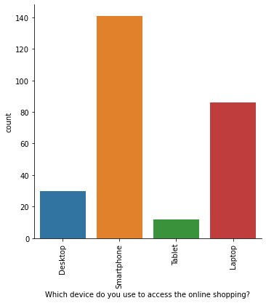
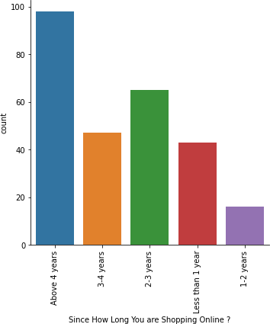
3.Exploratory Data Analysis Contd…
As we observed earlier that majority of population use Mobile internet so here we can see smartphone is the mostly used.
Majority of people are shopping from more than 4 years.

Slide 12
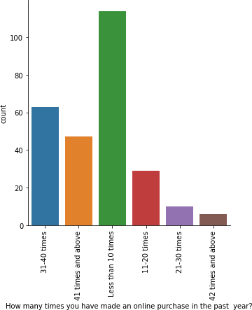
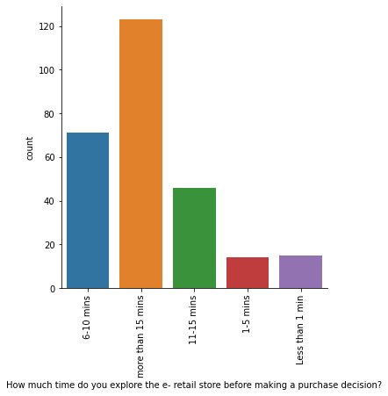
3.Exploratory Data Analysis Contd…
Majority of the respondents has shopped less than 10 times.
Very few are frequent buyers.
Majority of the respondents has shopped less than 10 times.
Very few are frequent buyers.

Slide 13
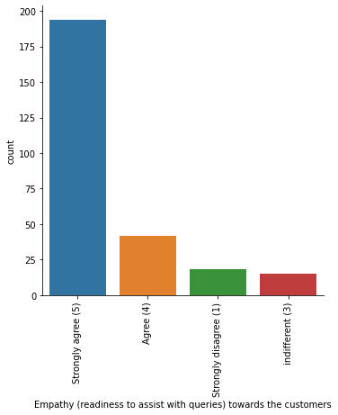
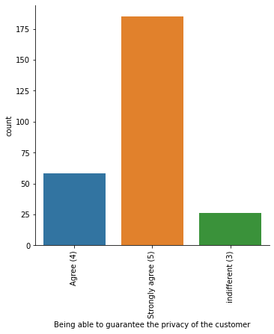
3.Exploratory Data Analysis Contd…
Customer support plays a very important role according to respondents.
Privacy is a very big concern.

Slide 14
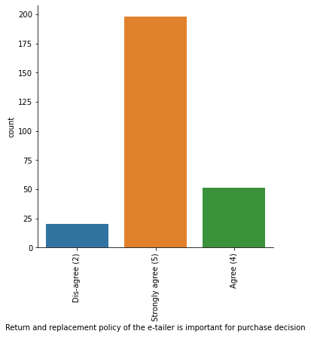
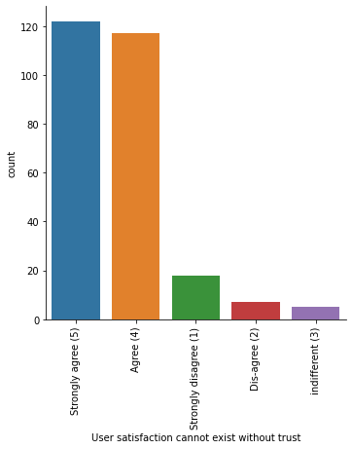
3.Exploratory Data Analysis Contd…
Return and replacement policy of the e-tailer is important for purchase decision according to the respondents.
Trust building is very essential to make shoppers shop online.

Slide 15
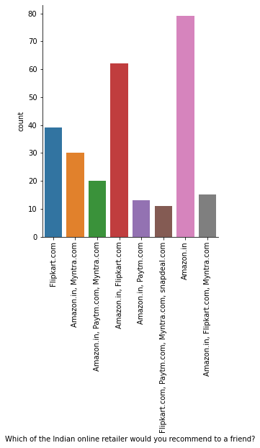
3.Exploratory Data Analysis Contd…
Amazon is the most recommended website by the respondents followed by Flipkart.

Slide 16
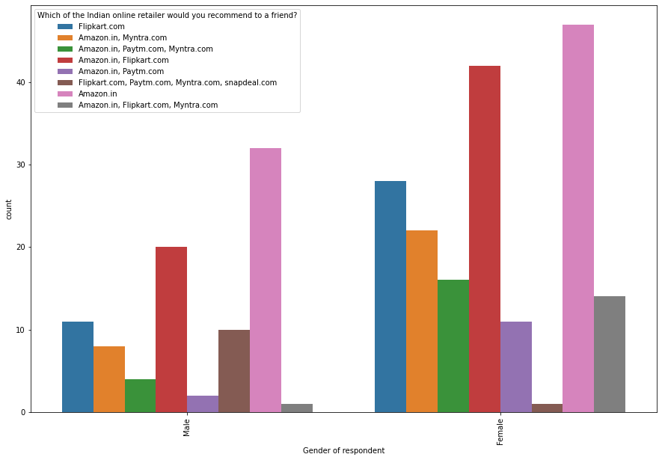
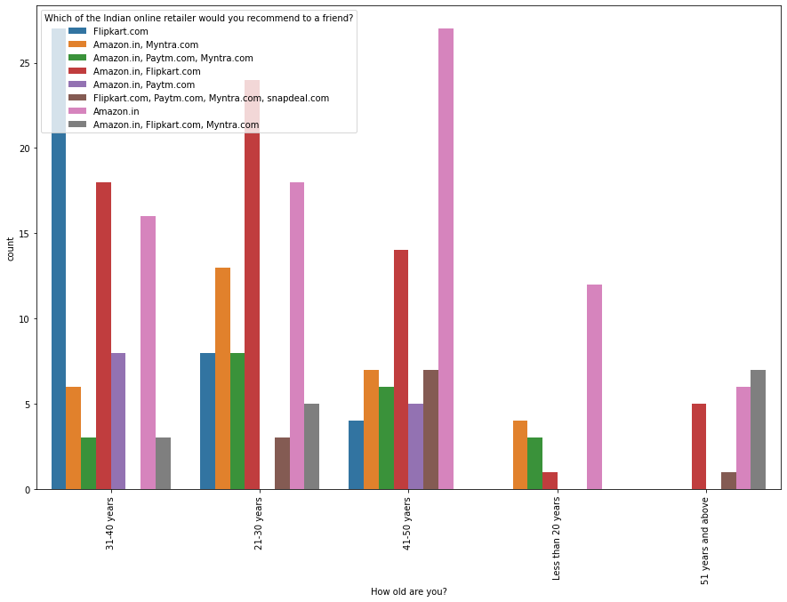
3.Exploratory Data Analysis Contd…
Bivariate Analysis
Flipkart is more popular among female users.
Female use more multiplatform for shopping than Male.
Flipkart is more popular among age group of 31-40 years people.
Amazon is recommended by all age group people

Slide 17
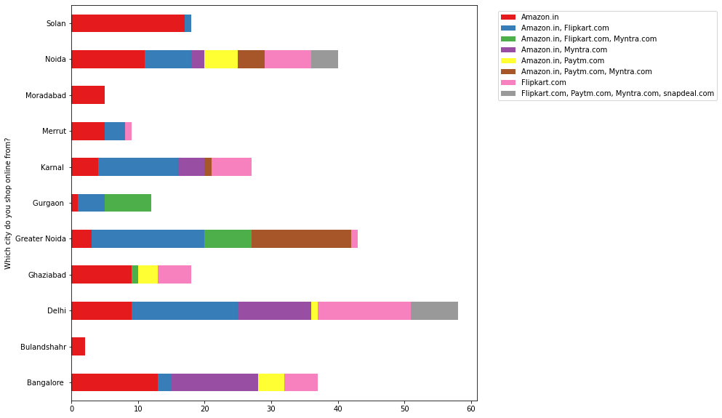
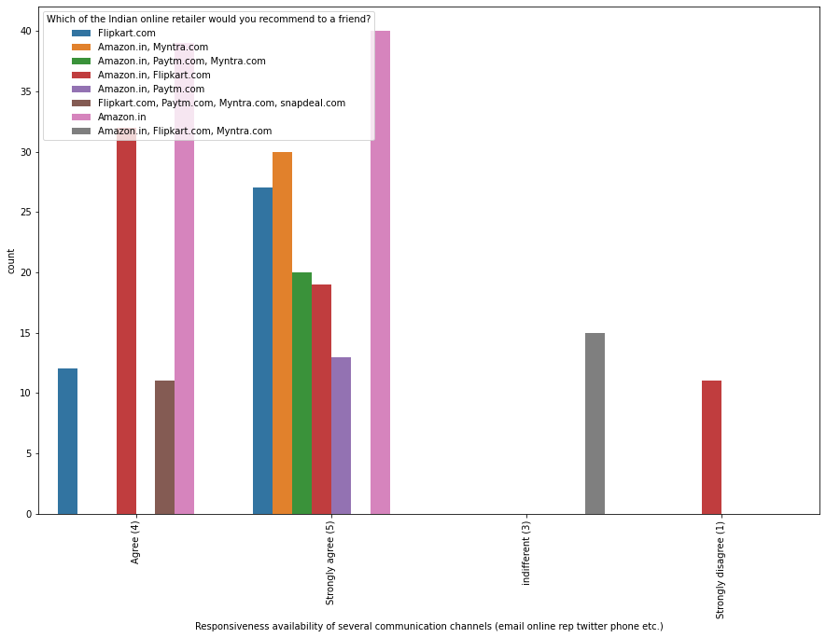
3.Exploratory Data Analysis Contd…
Cities with less shoppers prefer Amazon most for example Solan, Noida, Moradabad, Bulandshahr, Meerut
Cities with more number of shoppers recommends several platforms
Amazon and Flipkart has been recommended on responsiveness, availability of several communication channels (email, online rep, twitter, phone etc.)

Slide 18
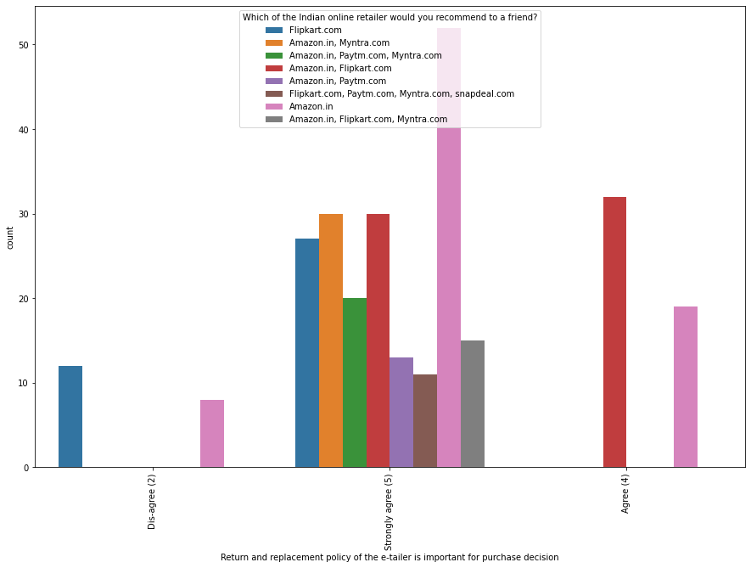
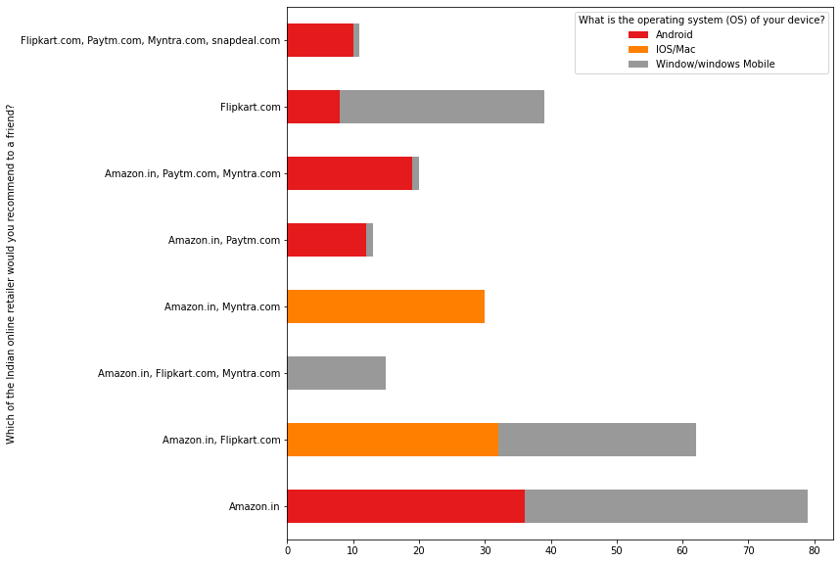
3.Exploratory Data Analysis Contd…
Amazon is recommended has it has best Return and replacement policy of the e-tailer is important for purchase decision
Respondents who use Window/window mobile are less likely to use Myntra.com
Respondents who uses IoS/Mac are more likely to use Myntra.com

Slide 19
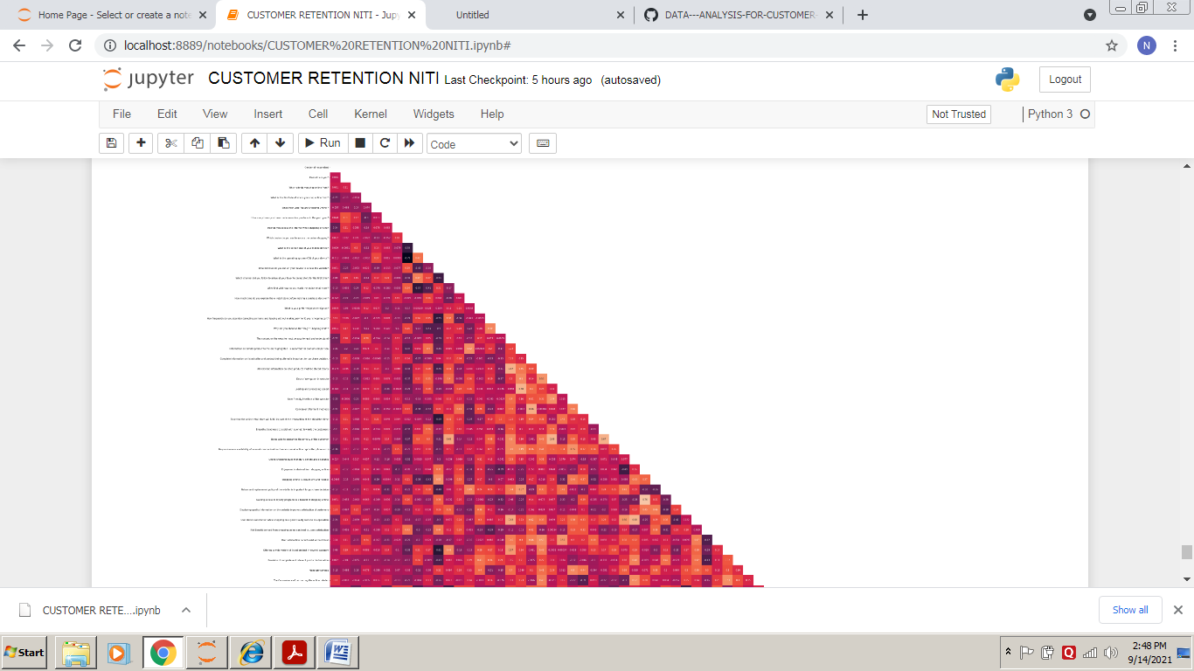
3.Exploratory Data Analysis Contd…
Multivariate Analysis
As there is so much variable so with heatmap we cant determine the correlation easily.
However the one thing we can say. There may be cases of multicollinearity.

Slide 20
3.Exploratory Data Analysis Contd…
Correlation Analysis
Top Positive Corelation
Complete relevant description information of products is 0.680926
Reliability of the website or application is 0.542711
Easy to use website or application is 0.541713
Presence of online assistance through multi-channel is 0.503836
Perceived Trustworthiness is 0.483457
Top Negative correlation
The content on the website must be easy to read and understand
-0.349016
Being able to guarantee the privacy of the customer -0.358734
All relevant information on listed products must be stated clearly -0.362879
Gaining access to loyalty programs is a benefit of shopping online -0.400583
Enjoyment is derived from shopping online -0.436613

Slide 21
Conclusion
As in the final conclusion in which user were asked which online retailer they would recommend to a friend. Most of the respondents says Amazon. in because it is providing all the features that users want. Website is efficient and it is fast loading , It give complete , relevant description and information of products . It is reliable and quick to complete the purchase. Amazon give speedy delivery to its customers and there is several payment option available on the website. It provide online assistance through multi channels. Providing good deals on products. Amazon have a user friendly interface and has visual appealing webpage layout. Amazon also offers wide variety of products and its application is easy to use. Lastly the main thing why user recommend it is because of its Trustworthiness and also its robust Security in protecting customer financial information and their Privacy information .
This paper investigated the factors that influence the online customers repeat purchase intention. During the process various data processing methods has been used to clean the data. The project contains extensive EDA considering every aspect. The major finding is Complete relevant description of products and reliability of the website increases chances of customer retention. However, if the content on the website in not easy to read and understand or can’t guarantee the privacy of the customer will lead to chances of customer retention. This project has increased my understanding of the concept. During the research I came across various challenges and while solving them I learned a lot of new things. How to plot different charts. For example, I learned how to plot subplot. How to handle legends manually. How to group data and visualize that. The limitation of the solution provided is that the data carried a lot of unrealistic values. Apart from that my laptop took to much time while running certain command where I lost a lot of precious time

Slide 22


